Slide 1

HOME WARRANTIES: A RENEWAL PREDICTION
ANDREW BARTON, CHRISTOPHER CALVO, & JACOB PAGELS
12.03.20
Notes:
Jake

Slide 2






AGENDA
INTRODUCTION
THE DATA
EDA
MODEL SELECTION CRITERIA
CLOSING
Notes:
Jake

Slide 3

INTRODUCTION
Goal of Analysis
We have chosen to analyze the success of a home warranty company in renewing their customers after their contract has expired. The rate at which customers renew after their contract expires is a crucial metric to the company’s ability to cover acquisition costs and increase profitability.
We plan to use logistic regression to determine if a customer will renew or not, based on available data.
Notes:
Jake

Slide 4

THE DATA
LET’S DIVE IN
Notes:
Chris

Slide 5
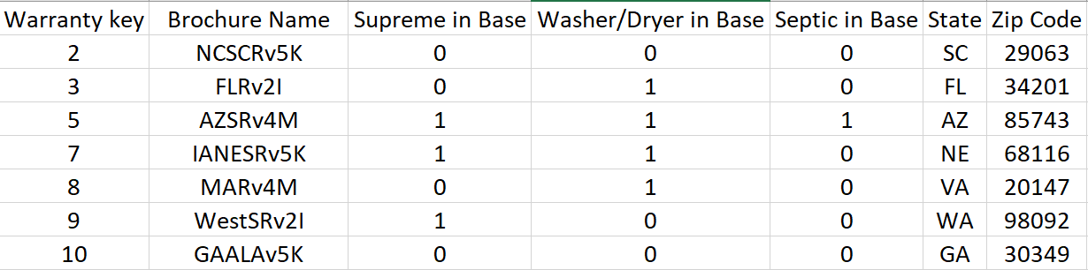
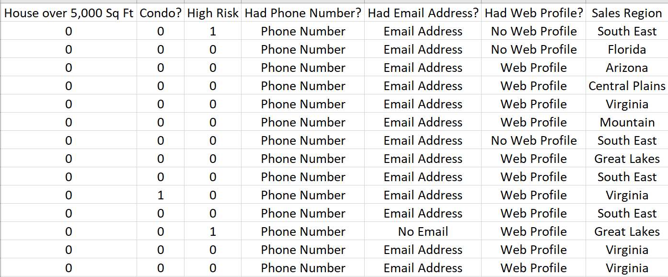
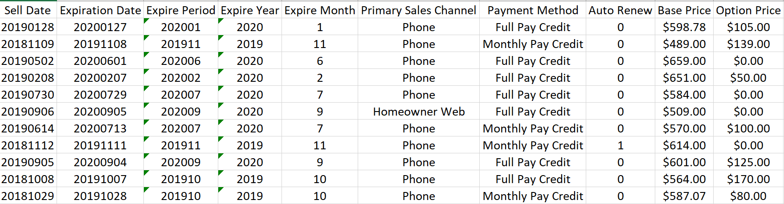
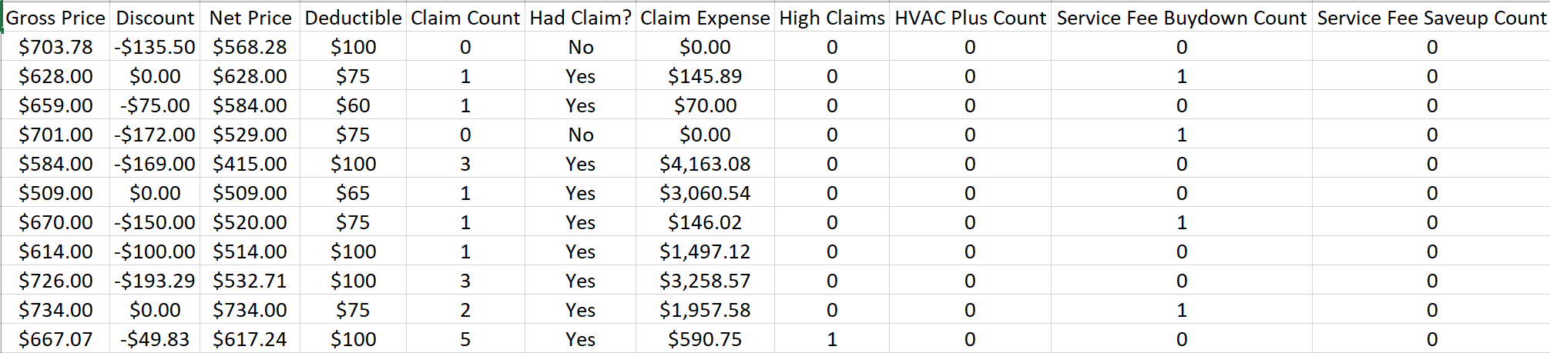
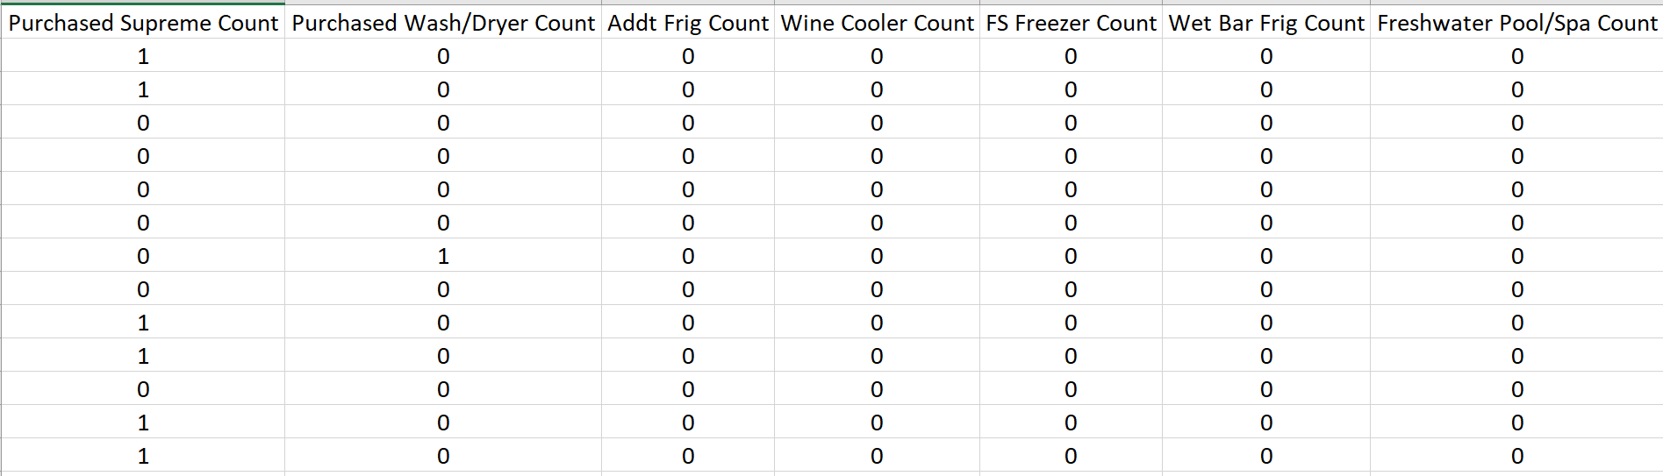
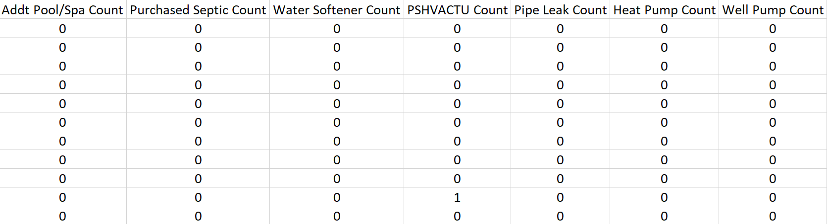
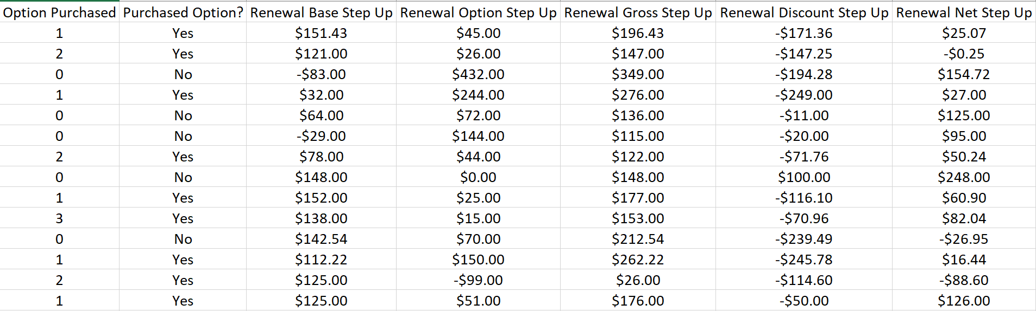
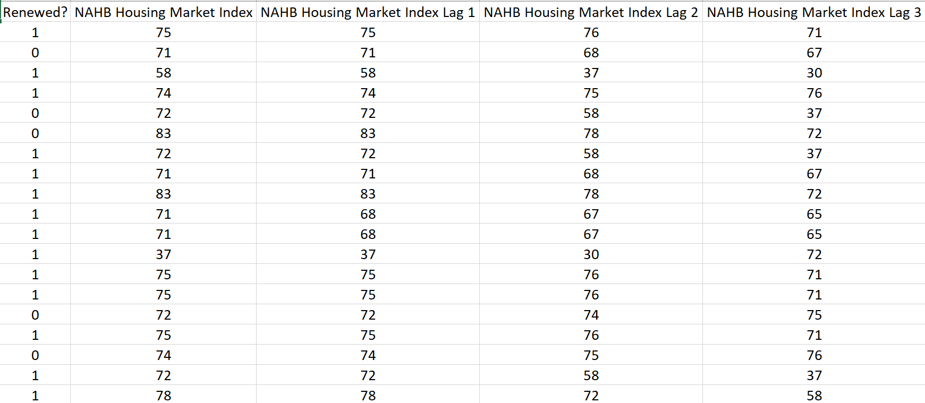
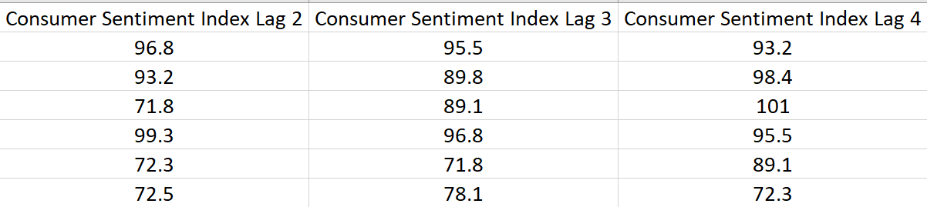
List of home warranties (12 month contracts)
demographic of customer
revenue received
claims filed
claims expense per warranty
options purchases
contact information
tenure of customer
address including state
renewal price
price step up (renewal price - price paid)
consumer sentiment index
housing trends
success of renewal (1 - renewed, 0 - did not renew)
Notes:
Chris

Slide 6

THE EDA LIBRARIES USED:
ROCR
pROC
Broom
Modelr
ggThemes
DPLYR
GGPLOT2
RESHAPE2
CORRPLOT
CAR
READXL
JANITOR
BOOT
MASS
OLSRR
CATOOLS
CARET
E1071
rpart
randomForest
Notes:
Chris

Slide 7
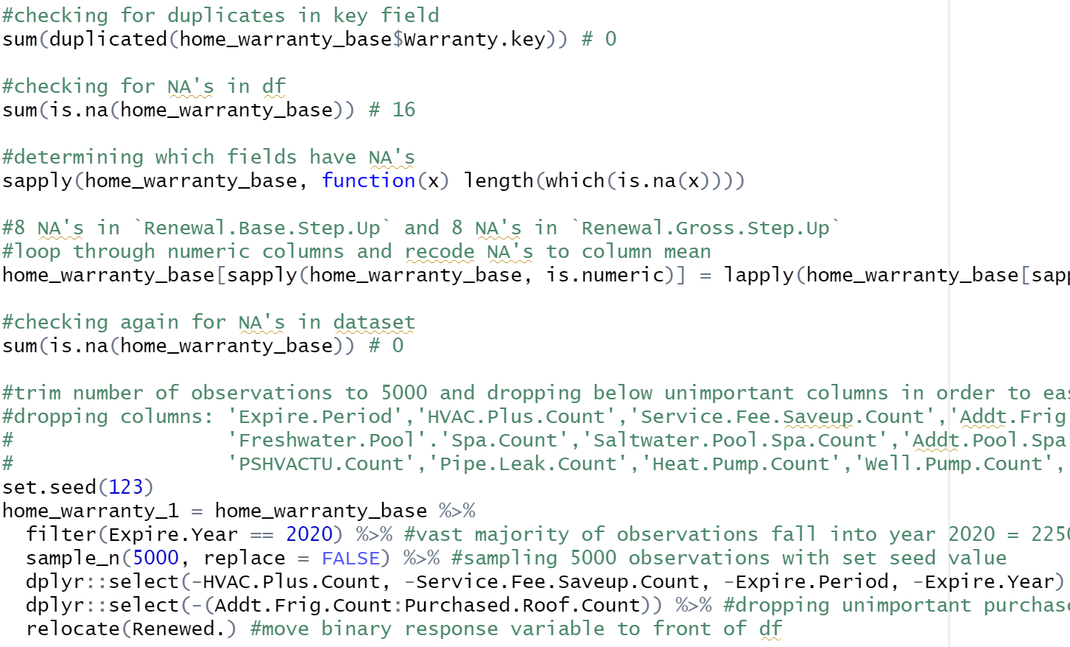
EDA PART 1
Cleaning the Data
Checking for duplicate entries
Checking for/handling NA values by recoding column mean
Trimming dataset to 5000 randomly selected rows from 29k observations with set seed to reproduce results
Notes:
Chris

Slide 8
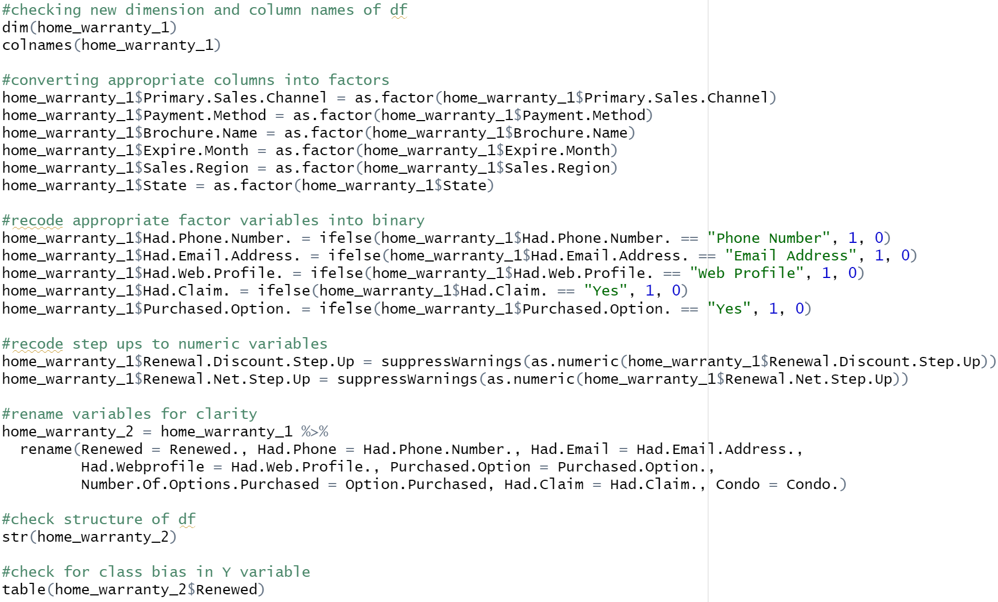
EDA PART 2
Verify dimensions & Column names of new Dataframe
Recoding appropriate values
Checking for class bias in binary response variable
Notes:
Drew

Slide 9

MODEL SELECTION CRITERIA
FULL MODEL
Cross Validation
Anova
Odds Ratio & Confidence Intervals
Cook’s distance values
Stepwise Method
Sort and Check for Highest VIF and low p values
Odds Ratio & Confidence Intervals
Final Model
What Works Best?
Notes:
Drew

Slide 10
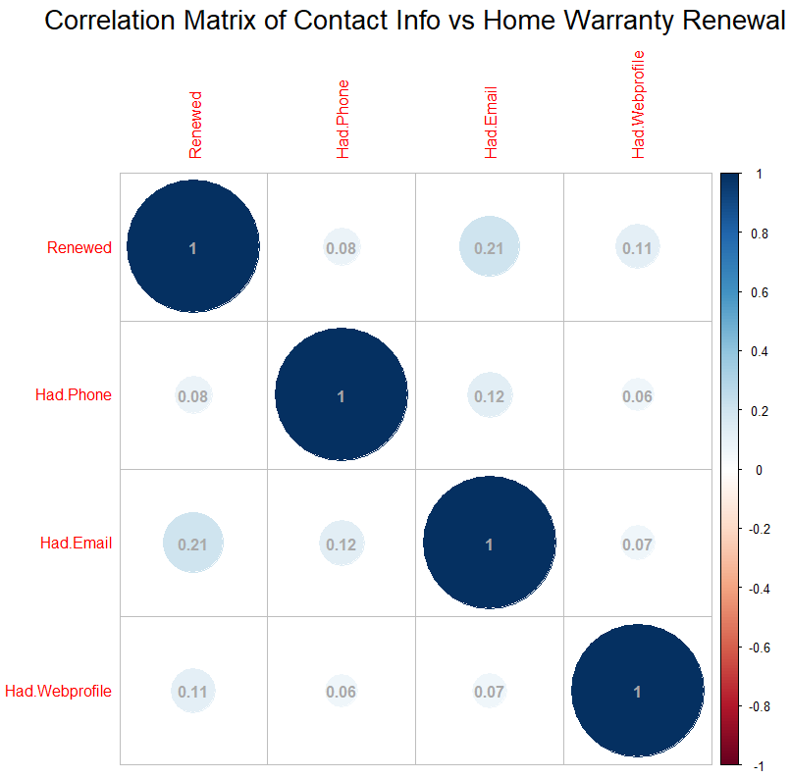
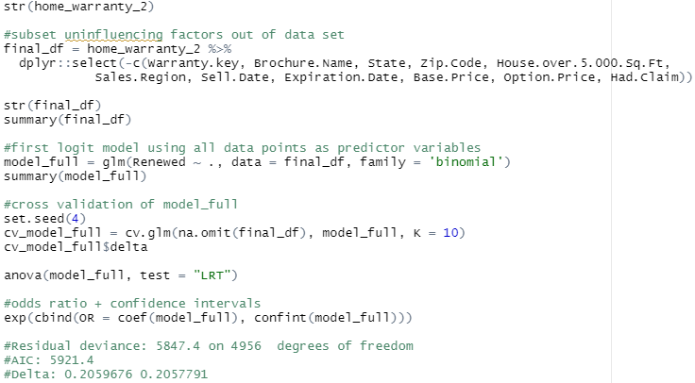
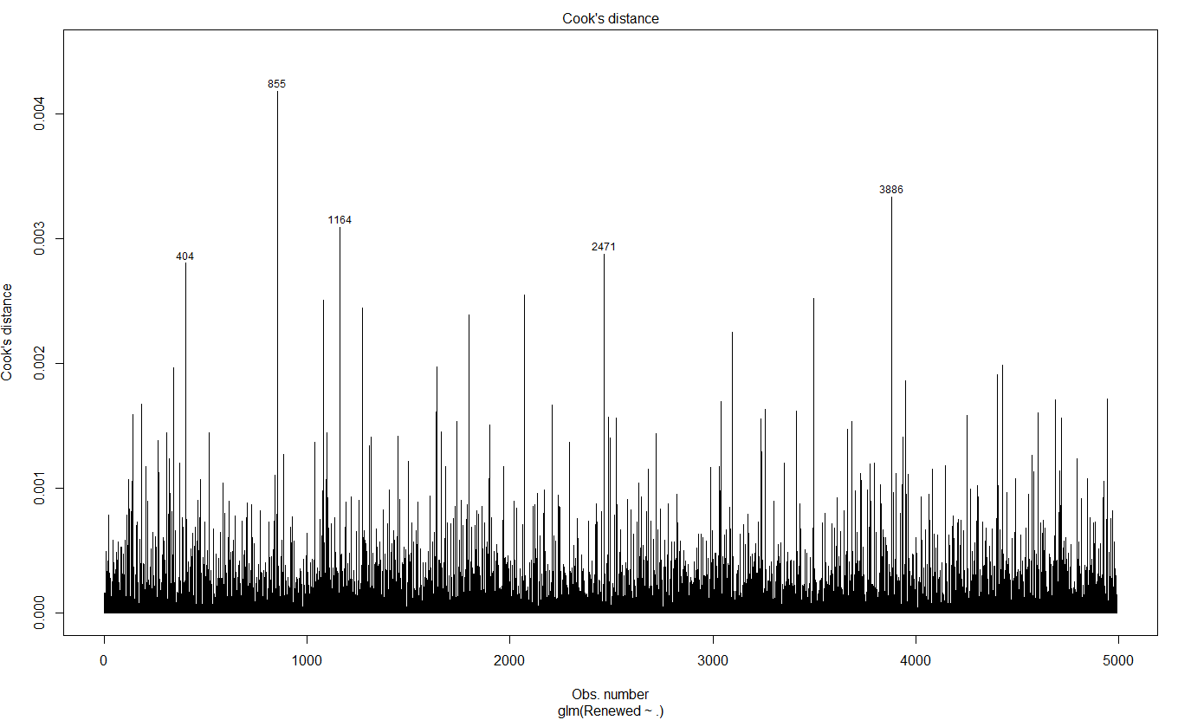
FULL MODEL
Ran glm on full data set and looked at overinfluencing factors using Cook’s distance.
Scaled change in fitted values to identify outliers in the X predictor values
Also ran correlations between contact info on file vs home warranty renewal success
Notes:
Drew

Slide 11
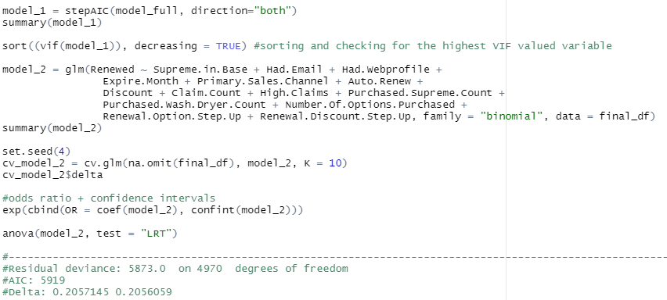
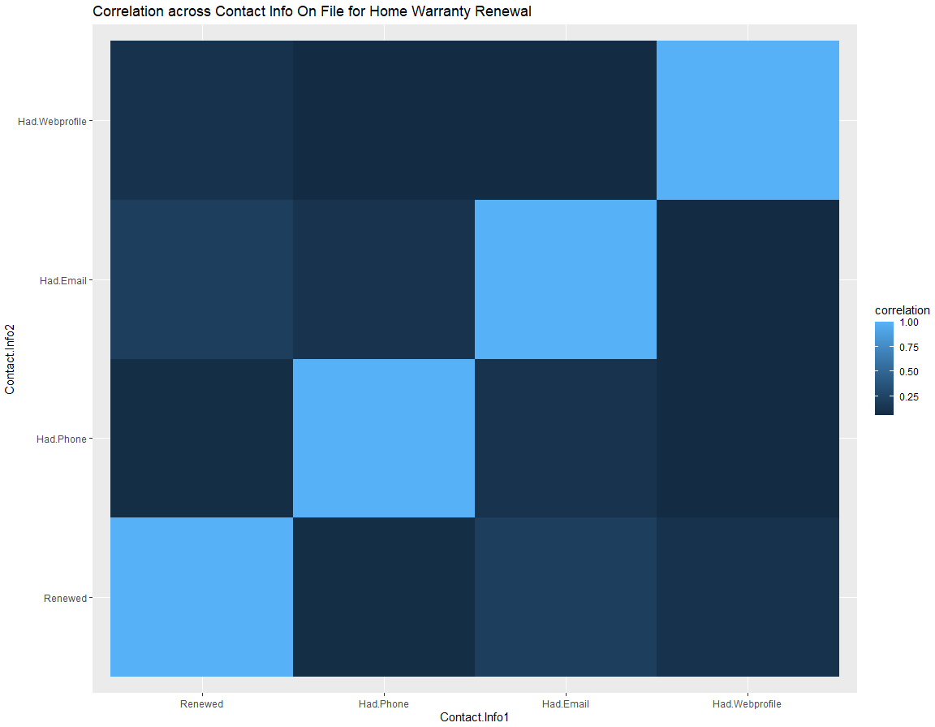
STEPWISE – STEPAIC
Step AIC used to simplify the model as a means for model selection without impacting much on the performance
Also removes the Multicollinearity if it exists
Truncated final model to 15 predictor variables
Notes:
Drew

Slide 12
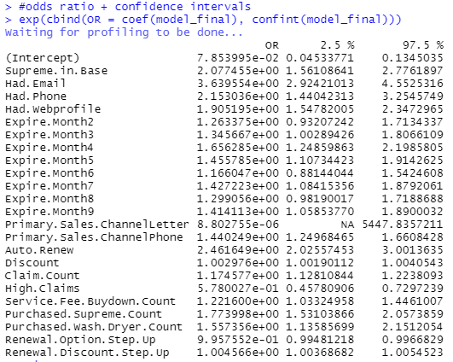
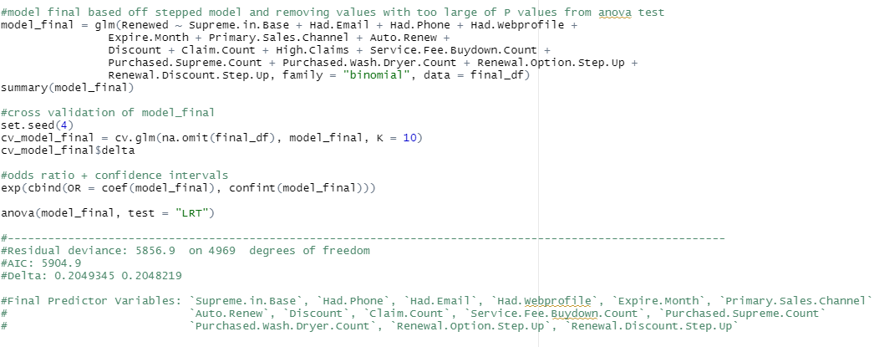
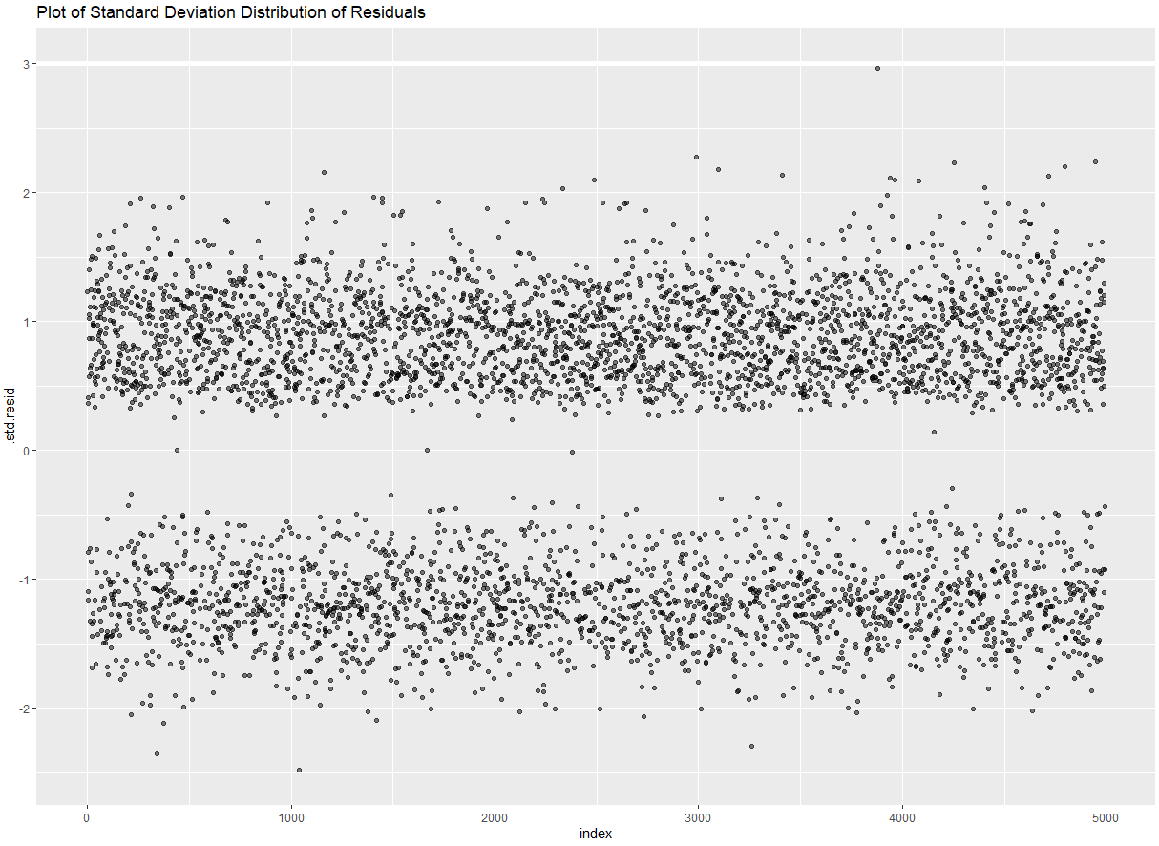
FINAL MODEL
Odds ratio showing constant likelihood of clients having high claims, a renewal option step up, and primary sales channel letter as factors having positive effect on renewal success
represents how the odds change with a 1 unit increase in that variable holding all other variables constant.
Residuals Distribution showing all within 3 Standard Deviations
Notes:
Drew

Slide 13

MODEL EVALUATION
IS THE MODEL PERFORMING WELL
Notes:
Drew

Slide 14
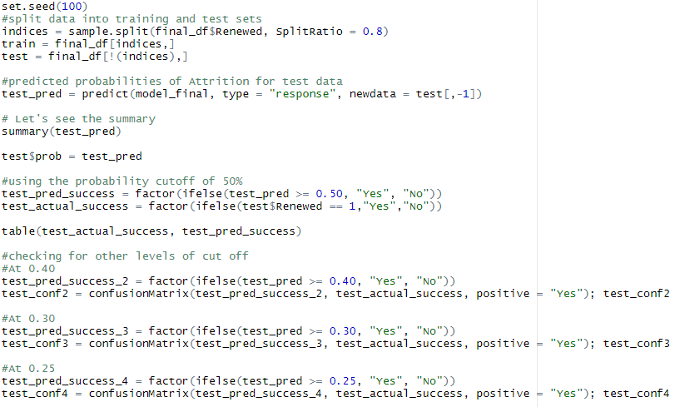
EVALUATION
Important to note that Pseudo R^2 is not a good value to represent accuracy as these are typically very low in logit models - (Hosmer and Lemeshow, in their textbook Applied Logistic Regression (2nd Ed.))
Obtained the predicted value that a client will renew on both training and testing set.
Used confusion matrices to describe the performance of our classification model (or "classifier") on the set of test data for which the true values are known
Calculated ROC AUC
Performed an evaluation on the training set by plotting the probability (score) estimated by our model with a double density plot.
Notes:
Drew

Slide 15
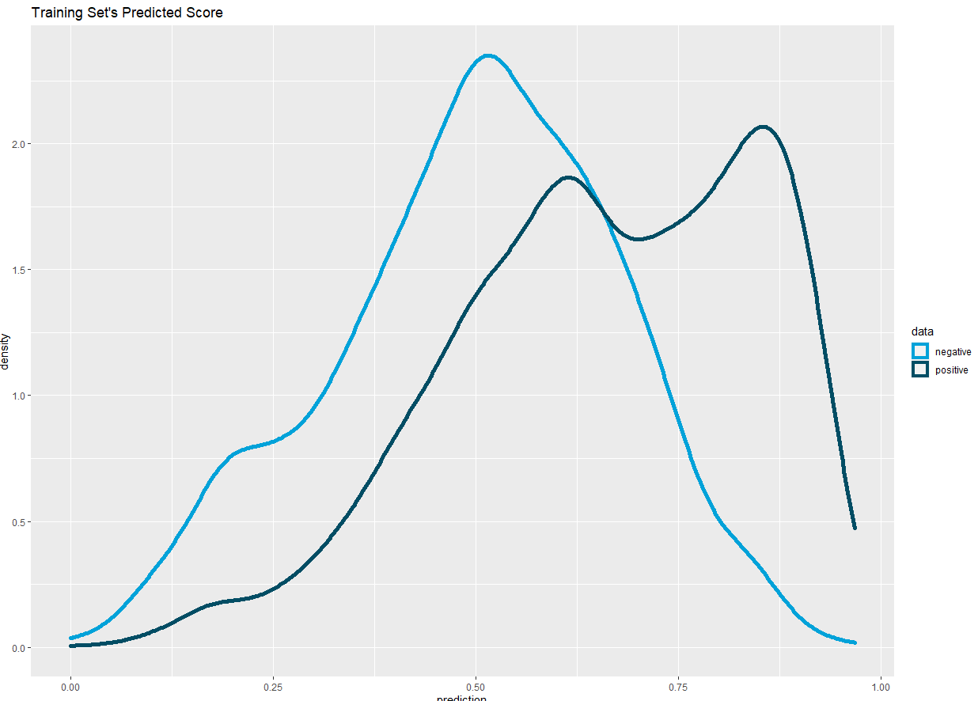
DOUBLE DENSITY PLOT
An ideal double density plot should have separated distribution of scores
negative instances in light blue on the left and positive instances in dark blue on the right
Our skewed double density plot, however, can tell us a very important thing: Accuracy will not be a suitable measurement for this model
i.e. When we use accuracy, we assign equal cost to false positives and false negatives however, as we have seen with the class bias, the data is imbalanced
Since the prediction of a logistic regression model is a probability, in order to use it as a classifier, we’ll have to choose a cutoff value, or you can say its a threshold value. Where scores above this value will classified as positive (renewal), those below as negative (non-renewal)
Best form of relative-to-class measure
ROC is relatively insensitive to false positives in the positive fraction compared with precision recall curves
Notes:
Drew

Slide 16
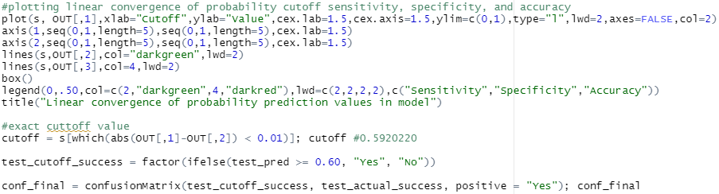
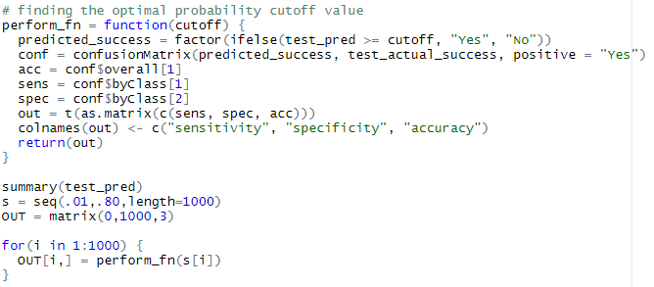
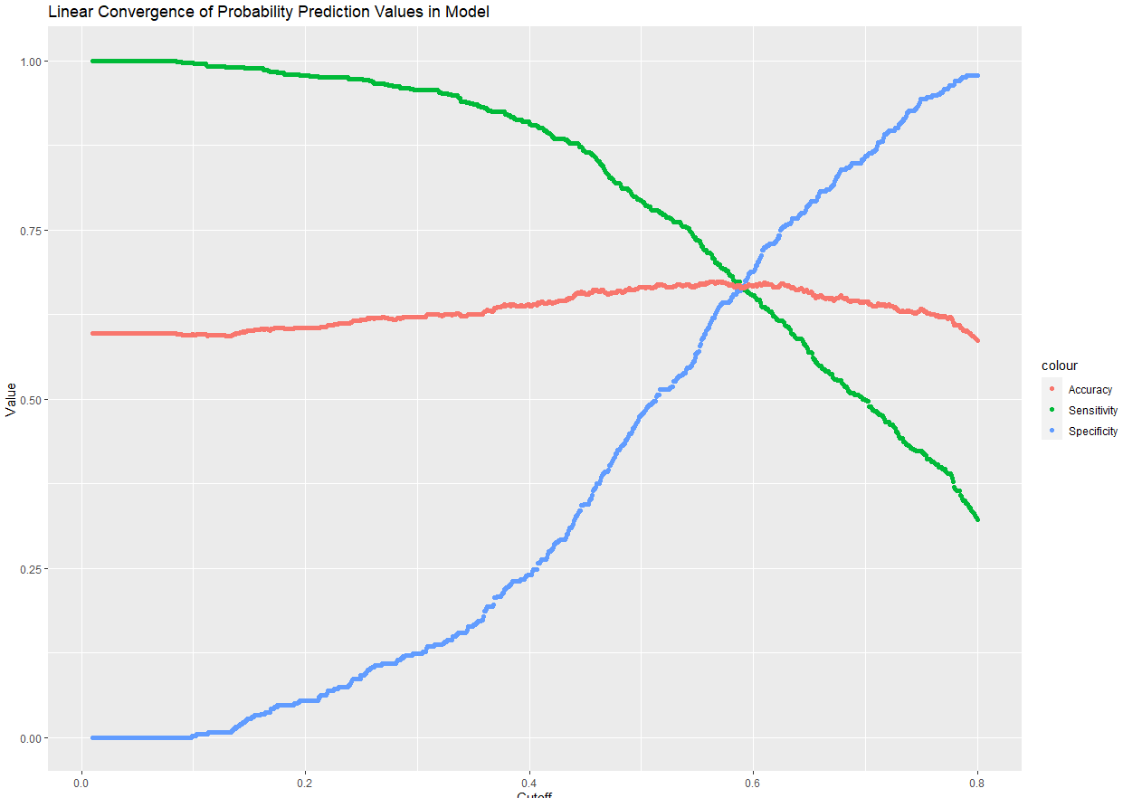
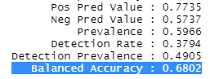
LINEAR THRESHOLD CONVERGENCE
Plotting the intersection of Accuracy, Sensitivity, and Specificity
Since accuracy score is calculated on the predicted classes (not prediction scores) we need to apply a certain threshold before computing it.
By increasing threshold value to 60% we decreased the model sensitivity and increased the specificity (rate at which we can predict True Positives)
Balanced prediction accuracy for new values based upon above threshold value:
68%
**Because of known unbalanced classification data, we looked at ROC curves rather than accuracy percentages
Notes:
Drew - Aim to get here by ~8 to 9 minutes max

Slide 17
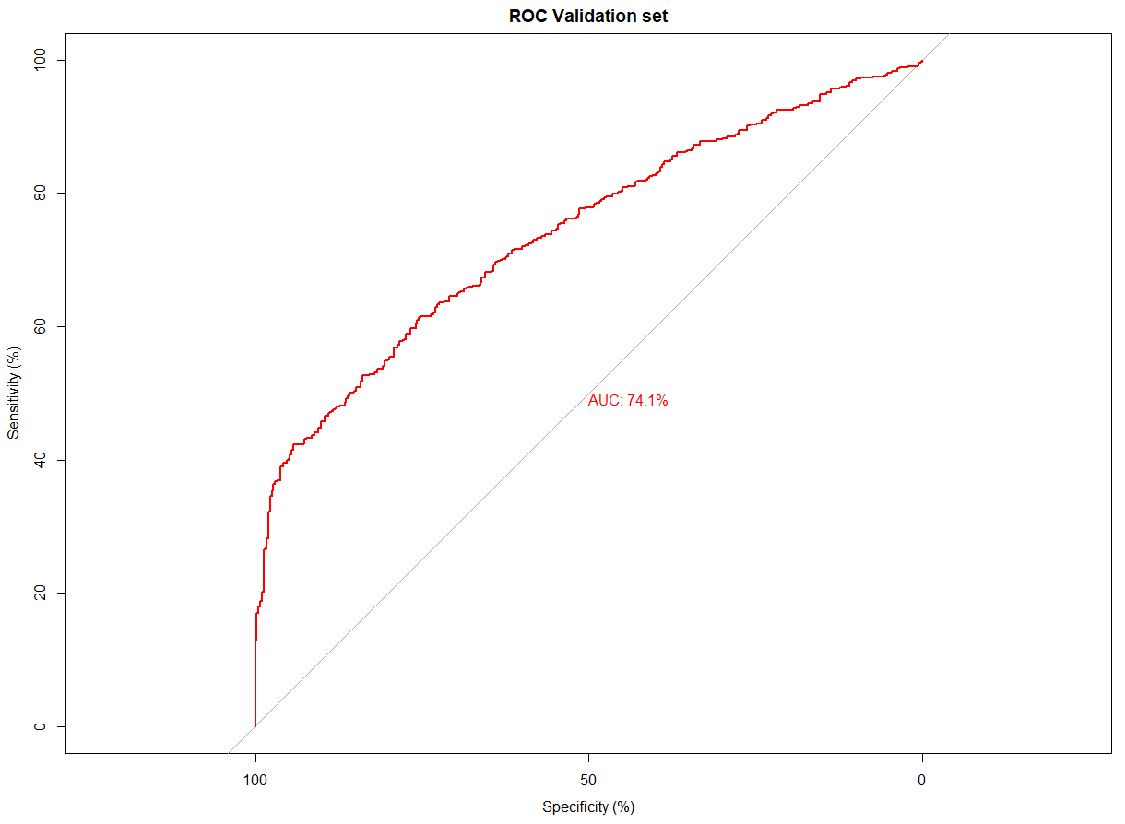
Receiver Operator Characteristic Curve
The ROC (receiver operator characteristic) curve for this model shows you the trade off between the rate at which you correctly predict values, verses the rate of incorrectly predicting values, while choosing different cutoffs.
The AUC (area under the ROC curve), measure ranging from 0 (False Positive Rate) to 1 (True Positive Rate), shows how well the classification model is performing in general
In this instance, 74.1% which signifies the algorithm’s rate of successful classification between positive class and negative class within model
Notes:
Drew

Slide 18

Machine Learning
Model Comparison
Notes:
Drew

Slide 19
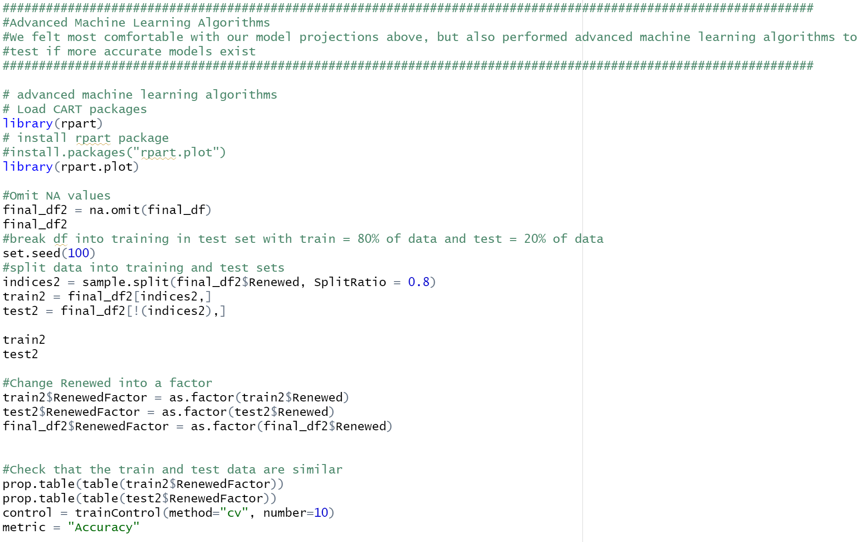
MACHINE LEARNING
Libraries
rPart
Creation of Training Data Set
Creation of Test Data Set
Validation
Notes:
Chris

Slide 20
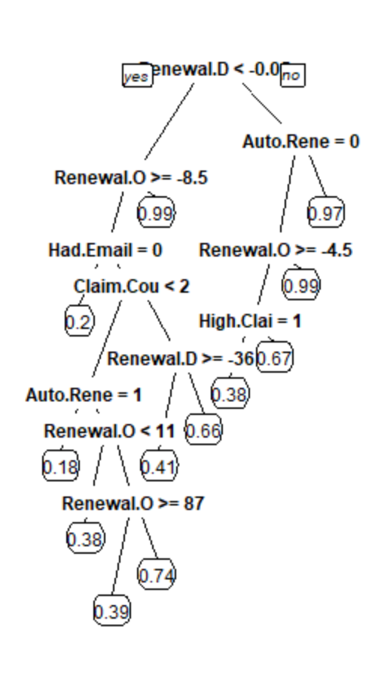
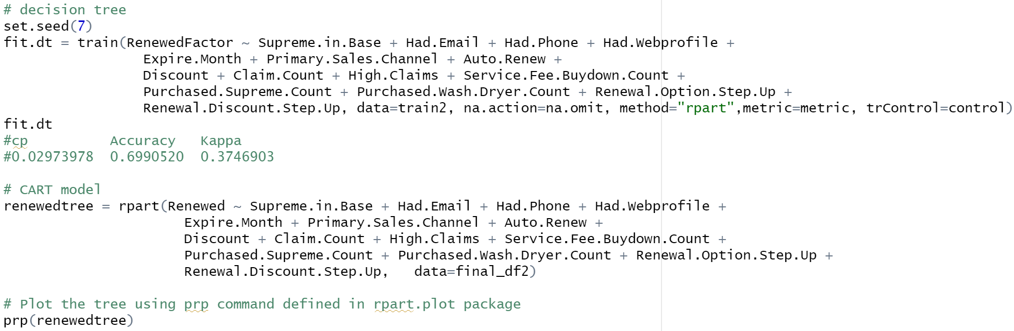
DECISION TREE
Notes:
Drew

Slide 21
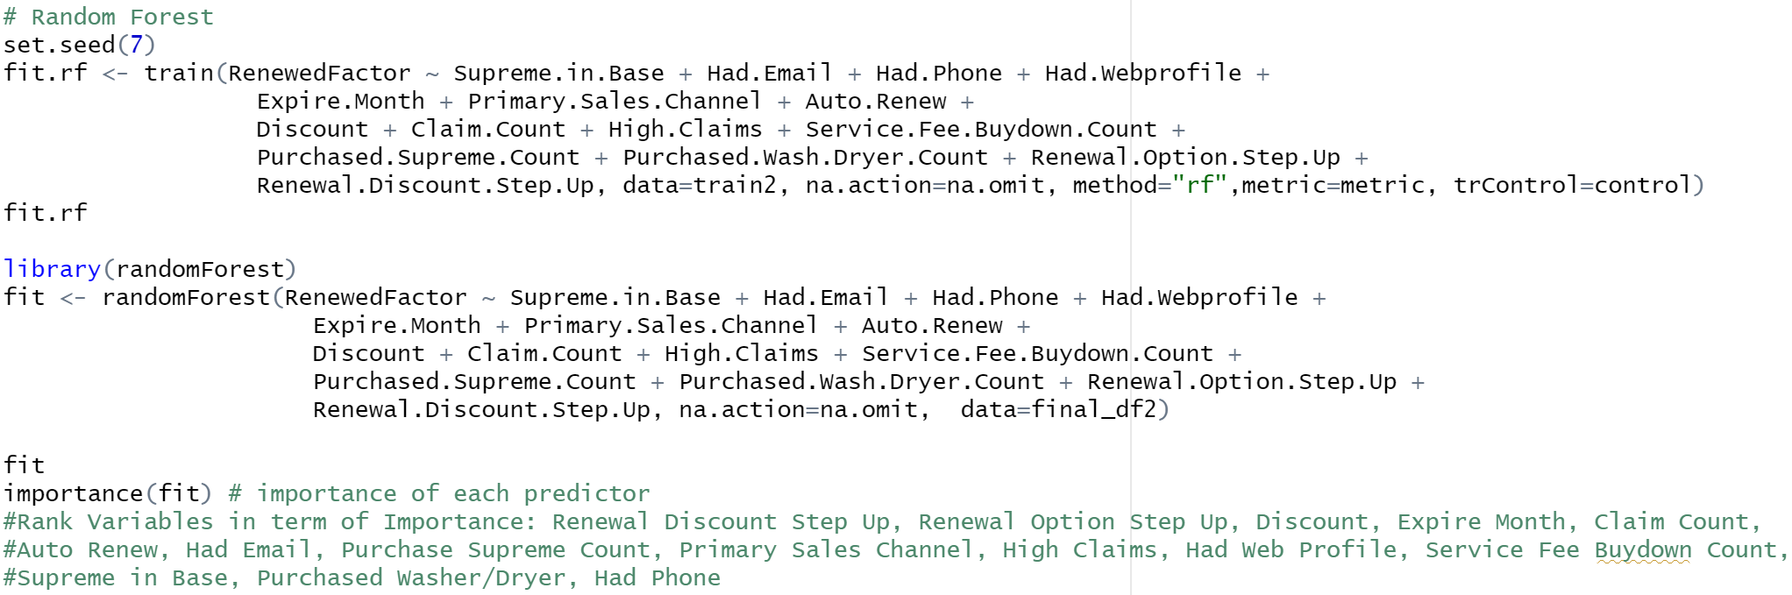
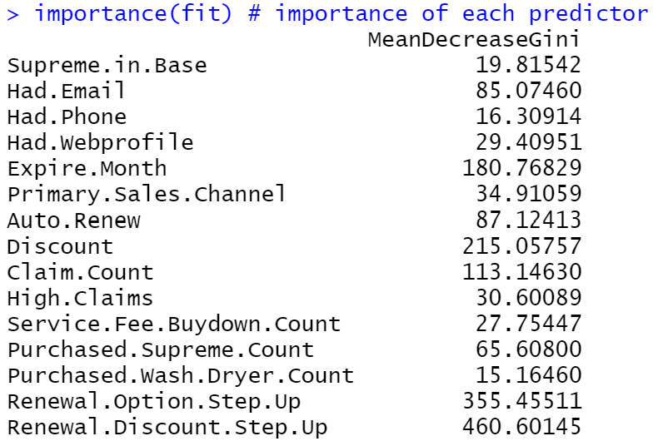
RANDOM FOREST
Notes:
Drew

Slide 22
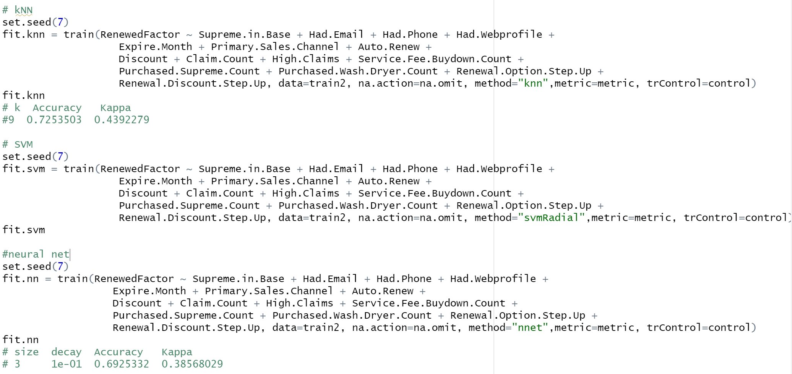
K NEAREST NEIGHBORS
Notes:
Drew

Slide 23
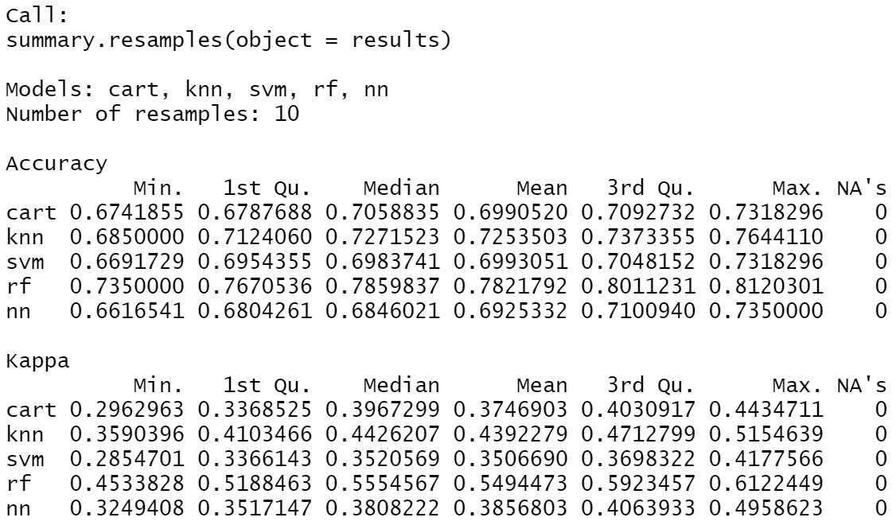
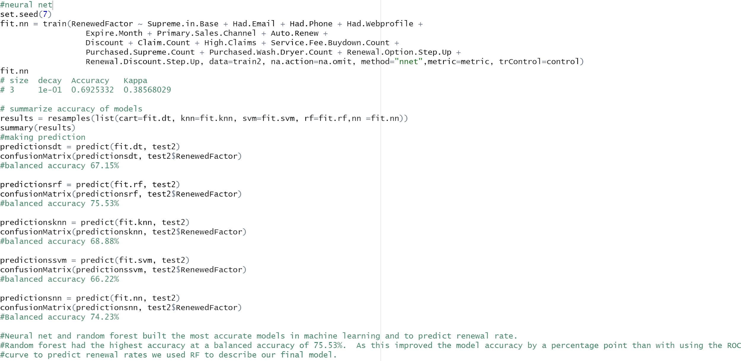
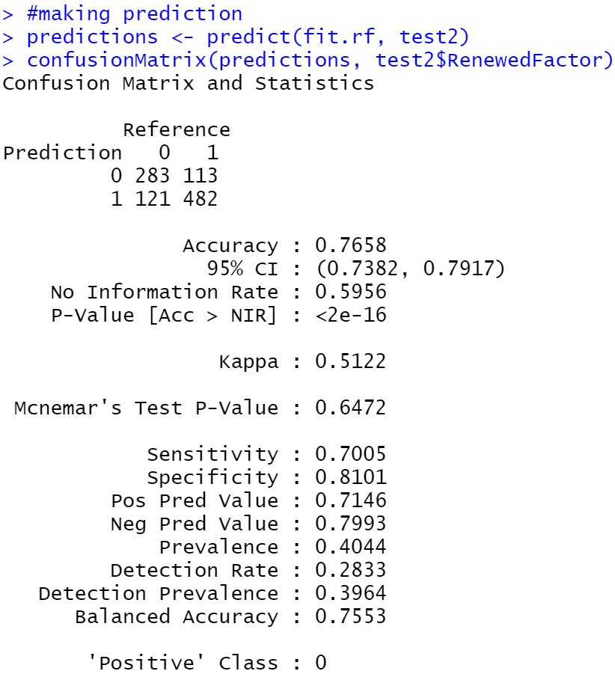
Machine Learning Summary
Notes:
Drew

Slide 24

Recommendations for Action
Preselect autorenew at checkout as the standard option, with a discount This will encourage the customer to renew due to convenience while also requiring them to actively deselect autorenew to decline.
Require contact information when original warranty is set up to increase the number of channels to market and sell the renewal to the customer.
Influence the customer to purchase service fee buydown and washer/dryer by changing the bonus structure for sales team to incentivize discounts tied to one of the listed options instead of a straight cash discount.
Include supreme within the standard coverage nationwide.
Notes:
Jake

Slide 25

THANK YOU
The final model can classify between Home Warranty Renewal success and failure at a 75.5% probability rate
Questions?
Notes:
Jake

